Slide 1

Karpenter for AWS EKS autoscaling
Mohamed Kerbachi
Notes:
This is the 2019 February edition of Aegon’s corporate PowerPoint template and corporate presentation.
This slide deck provides an introduction to Aegon, its purpose and strategy, its focus on life insurance, pensions and asset management and its extensive international presence.
This slide deck provides at the same time Aegon’s corporate PowerPoint template, which has been updated for the latest Brand guidelines, as established by Aegon’s Brand Board. The basic structure of the template remained the same, due to which slides from the previous template can be quite easily re-used. If you need any help with that, please don’t hesitate to reach out to Group Corporate Communications.
This 2019 February edition, reflects the latest updates on Aegon’s strategy, the company plans going forward and the 2H2018/full year 2018 results.
In an appendix you will find some guidelines for the use of this template and the colors.
We are phasing out the use of the Aegon logo with the tagline ‘Transform Tomorrow’. If you are incorporating slides from existing presentations, please be so kind as to ensure that the right Aegon logo is shown on all pages.
If you have any questions, please don’t hesitate to reach out to Group Corporate Communications – Marjolein Dekker at marjolein.dekker@aegon.com.

Slide 2


Introduction
Overview
This is an update of AWS EKS component standard to add Karpenter as a scaling management tool for AWS EKS Clusters.

Slide 3

Business Value
Improved Resource Efficiency:
Right sizing
Less management overhead
Cost Optimization:
Dynamic Capacity Provisioning
Elimination of wasteful resources
Reduced Infrastructure Cost
Use AWS EC2 Spot (~70% savings)
Rapid Scale and Agility
Faster Scaling
Business Agility
Easier Compliance & Governance:
Policy-Based Provisioning
Monitoring and Logging

Slide 4

Functionality
Dynamic Node Provisioning: Automatically spins up Kubernetes nodes instantly based on real-time workload demands.
Intelligent Node Selection: Chooses optimal EC2 instance types (CPU, memory, GPU, etc.) tailored explicitly for workloads.
Resource Optimization: Continuously analyzes and eliminate underutilized infrastructure, optimizing cloud expenditure.
Provisioner Constraints and Policies: Allow users to enforce compliance such instance types, regions, budgets, and security constraints.
Simplified Operations: Reduces infrastructure management overhead by automating the node lifecycle, enhancing administrator and developers' productivity.
Security and IAM integration: Seamless integration with IAM roles, and AWS security best practices to ensure secure deployments and node management.
Availability Zone Management: Automated AZ balancing and enables flexible capacity management across multiple Azs.
Observability and Monitoring: Integrates with CloudWatch, and AWS tolls for monitoring and audit logging.
Extensibility and Customization: Allows flexible customization through provisioner specs to meet specific technical or compliance needs.
Environment Sustainability: Reduces idle infrastructure and environment footprint by dynamically matching workload demands to resource provisioning.

Slide 5
Comparative Analysis of Karpenter vs. ASG using AWS Well-Architected Framework
AWS Well-Architected Framework | Functionality | Karpenter | EKS Cluster Autoscaler
 | Brief Description | Open-source, workload-aware autoscaler that rapidly provisions optimal nodes based on workload needs. | Kubernetes autoscaling tool managing node groups and ASGs to scale clusters based on pod demand.
Operational Excellence | Provisioning Speed | ✅ Very fast (seconds) | ❌ Slow (minutes, AWS ASGs constraint)
 | Operational Simplicity | ✅ High automation, minimal configuration | ❌ Manual operations required (ASGs, node groups)
 | Lifecycle & Maintenance | ✅ Fully automated, low overhead | ❌ More manual effort (updates, upgrades to ASGs)
 | Integration Complexity | ✅ Simple, Kubernetes-native | ❌ Moderate complexity (managing multiple ASGs)
Cost Optimization | Cost Efficiency | ✅ High efficiency (right sizing, spot instances) | ❌ Low/medium efficiency; tends to over-provision
 | Spot-instance Management | ✅ Built-in, dynamic selection | ❌ Limited; requires separate ASGs
Performance Efficiency | Availability Zone Balancing | ✅ Automatic balancing across AZs | ❌ Limited (requires manual ASG/AZ management)
 | Scaling Accuracy | ✅ Precise sizing according to workloads | ❌ Approximate (fixed instance types per ASG)

Slide 6
Comparative Analysis of Karpenter vs. ASG using AWS Well-Architected Framework
AWS Well-Architected Framework | Functionality | Karpenter | EKS Cluster Autoscaler
 | Brief Description | Open-source, workload-aware autoscaler that rapidly provisions optimal nodes based on workload needs. | Kubernetes autoscaling tool managing node groups and ASGs to scale clusters based on pod demand.
Reliability (Resilience & Stability) | Community & AWS Support | ✅ Strong AWS backing, growing community | ✅ Mature community support
 | Production Readiness | ✅ Fully production ready, AWS recommended | ✅ Widely used, fully production ready
Observability & Transparency | Transparency & Observability | ✅ Integrated AWS observability & metrics | ✅ Good observability via AWS & community tools
Security & Governance | Governance & constraint flexibility | ✅ High flexibility & fine-grained controls | ❌ Limited governance via static ASG/node groups
 | Node Customization Security (AMIs) | ✅ Flexible AMI launch template customization | ❌ Limited to predefined ASG/launch template

Slide 7
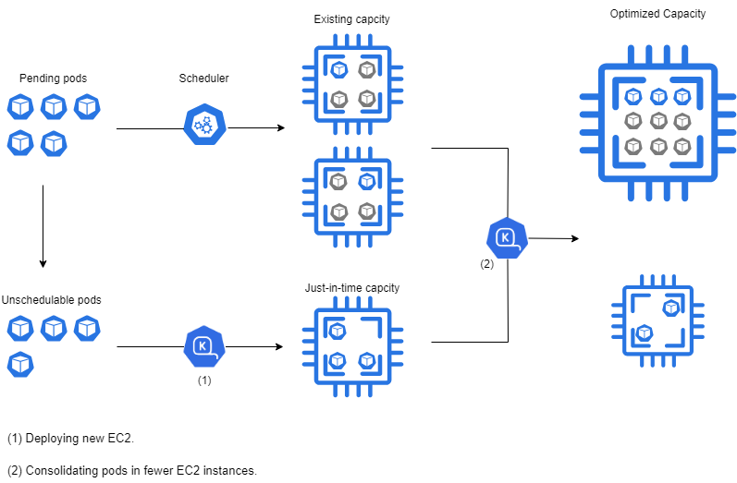
Scheduling and consolidating resources

Slide 8
Guardrails: Security
Attributes | Description
Access control | Strict RBAC policies will be implemented to control who can interact with Karpenter resources. AWS IAM Roles for Service Accounts (IRSA) will be used to map Kubernetes Services Account used by Karpenter to AWS IAM Roles.
Encryption | Encryption at transit: Enforce standard TLS encryption (TLS 1.2 or 1.3 preferred) to secure communications.
Regular reviews | Periodically review role assignments to ensure they are still appropriate and adjust as needed.
Network | Define least privilege security groups for EC2 nodes with minimal necessary inbound and outbound network rules and avoid using wildcard permissions. New AMIs will be evaluated in a lower environment before rolling them out into production environment.
Resiliency
Attributes | Description
Resiliency | Karpenter and AWS EKS coordinated upgrade to ensure compatibility as recommended by Amazon.
Notes:
1 – Tag needs to be mapped to CMDB
2 – The CI and Name will be validated against CMDB and then mapped back to the CMDB and associated with the resources.

Slide 9

Security and Encryption

Slide 10

Questions

